Slide 2
Topics
Introduction
Hardware and Software
How Computers Store Data
How a Program Works
Using Python

Slide 3
Introduction
Computers can be programmed
  Designed to do any job that a program tells them to
Program: set of instructions that a computer follows to perform a task
  Commonly referred to as Software
Programmer: person who can design, create, and test computer programs
  Also known as software developer

Slide 4
Hardware and Software
Hardware: The physical devices that make up a computer
  Computer is a system composed of several components that all work together
Typical major components:
  Central processing unit
  Main memory
  Secondary storage devices
  Input and output devices

Slide 5
The CPU
Central processing unit (CPU): the part of the computer that actually runs programs
  Most important component
  Without it, cannot run software
  Used to be a huge device
Microprocessors: CPUs located on small chips

Slide 6
Main Memory
Main memory: where computer stores a program while program is running, and data used by the program
Known as Random Access Memory or RAM
  CPU is able to quickly access data in RAM
  Volatile memory used for temporary storage while program is running
  Contents are erased when computer is off

Slide 7
Secondary Storage Devices
Secondary storage: can hold data for long periods of time
  Programs normally stored here and loaded to main memory when needed
Types of secondary memory
  Disk drive: magnetically encodes data onto a spinning circular disk
  Solid state drive: faster than disk drive, no moving parts, stores data in solid state memory
  Flash memory: portable, no physical disk

Slide 8
Input Devices
Input:
  data the computer collects from people and other devices
Input device: component that collects the data
  Examples: keyboard, mouse, touchscreen, scanner, camera

Slide 9
Output Devices
Output: data produced by the computer for other people or devices
  Can be text, image, audio, or bit stream
Output device: formats and presents output
  Examples: video display, printer

Slide 10
How Computers Store Data
All data in a computer is stored in sequences of 0s and 1s
Byte: just enough memory to store letter or small number
  Divided into eight bits
  Bit: electrical component that can hold positive or negative charge, like on/off switch
  The on/off pattern of bits in a byte represents data stored in the byte

Slide 11
Storing Numbers
Bit represents two values, 0 and 1
Computers use binary numbering system
  Position of digit j is assigned the value 2^{j-1}
  To determine value of binary number sum position values of the 1s
Byte size limits are 0 and 255
  0 = all bits off; 255 = all bits on
  To store larger number, use several bytes

Slide 12
Compilers and Interpreters
Programs written in high-level languages must be translated into machine language to be executed
Compiler: translates high-level language program into separate machine language program
  Machine language program can be executed at any time

Slide 13
Compilers and Interpreters (cont’d.)
Interpreter: translates and executes instructions in high-level language program
  Used by Python language
  Interprets one instruction at a time
  No separate machine language program
Source code: statements written by programmer
  Syntax error: prevents code from being translated

Slide 14
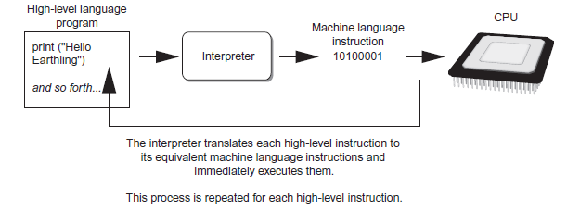
Compilers and Interpreters (cont’d.)
Figure 1-19 Executing a high-level program with an interpreter

Slide 15
Summary
This chapter covered:
  Main hardware components of the computer
  Types of software
  How data is stored in a computer
  Basic CPU operations and machine language
  Complex languages and their translation to machine code

